Slide 1

New Product Development & Product Life-Cycle Strategies
Lecture 6 | Chapter 9

Slide 2

Learning Objectives
9.1 Explain how companies find and develop new product ideas.
9.2 List and define the steps in the new product development process and the major considerations in managing this process.
9.3 Describe the stages of the product life cycle and how marketing strategies change during a product’s life cycle.
9.4 Discuss two additional product issues: socially responsible product decisions and international product and services marketing.
Notes:
Objective 1 Explain how companies find and develop new product ideas.
Objective 2 List and define the steps in the new product development process and the major considerations in managing this process.
Objective 3 Describe the stages of the product life cycle and how marketing strategies change during a product’s life cycle.
Objective 4 Discuss two additional product issues: socially responsible product decisions and international product and services marketing.

Slide 3
New Product Development Strategy
New ways to obtain new products
Acquisition refers to the buying of a whole company, a patent, or a license to produce someone else’s product.
New product development refers to original products, product improvements, product modifications, and new brands developed from the firm’s own research and development.

Slide 4
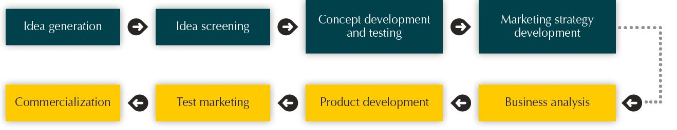
New Product Development Process
Major Stages in New Product Development

Slide 5
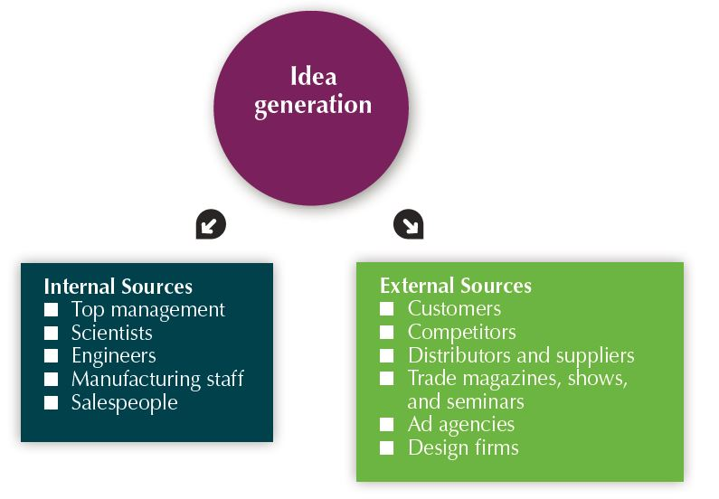
New Product Development Process
Idea Generation
Idea generation is the systematic search for new product ideas.
Sources of new product ideas
Internal
External

Slide 6
New Product Development Process
(1) Idea Generation
Internal sources refer to the company’s own formal research and development, management and staff, and intrapreneurial programs.
External sources refer to sources outside the company such as customers, competitors, distributors, suppliers, and outside design firms.
Crowdsourcing involves inviting broad communities of people—customers, employees, independent scientists and researchers, and even the public at large—into the new product innovation process.
Truly innovative companies don’t rely only on one source or another for new product ideas. Instead, they develop extensive innovation networks that capture ideas and inspiration from every possible source, from employees and customers to outside innovators and multiple points beyond.

Slide 7
New Product Development Process
(2) Idea Screening
Identify good ideas and drop poor ideas
R-W-W screening framework:
Is it real?
Can we win?
Is it worth doing?

Slide 8
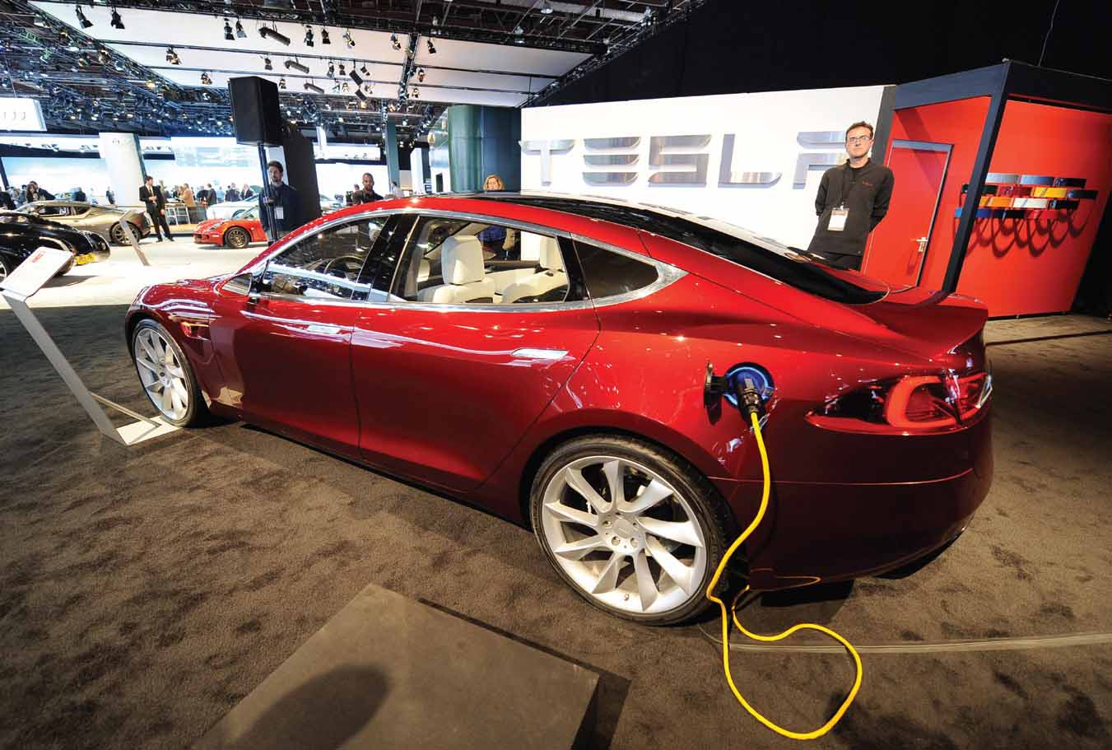
New Product Development Process
(3) Concept Development and Testing
An attractive idea must then be developed into a product concept.
Product idea – possible product to be sold in the market
Product concept – detailed version of the idea stated in meaningful consumer terms
Product image – consumers’ perception of the potential product
Concept testing refers to testing new product concepts with groups of target consumers.

Slide 9
New Product Development Process
(4) Marketing Strategy Development
Marketing strategy development is designing an initial marketing strategy for a new product based on the product concept.
Marketing strategy statement consists of:
Target market description
Value proposition planned
Sales, market-share, and marketing mix

Slide 10

New Product Development Process
(5) Business Analysis
Business analysis is a review of the sales, costs, and profit projections for a new product to find out whether these factors satisfy the company’s objectives.

Slide 11
New Product Development Process
(6) Product Development
Product development is developing the product concept into a physical product to ensure that the product idea can be turned into a workable market offering.

Slide 12
New Product Development Process
(7) Test Marketing
Test marketing is the stage of new product development in which the product and its proposed marketing program are tested in realistic market settings.
Test Marketing Strategy Development
When test marketing is likely | When test marketing is unlikely
New product with large investment | Simple line extension
Uncertainty about product or marketing program | Copy of competitor product Low costs Management confidence

Slide 13
New Product Development Process
(8) Commercialization
Commercialization involves introducing a new product into the market.
When to launch?
Where to launch?
Planned market rollout?

Slide 14
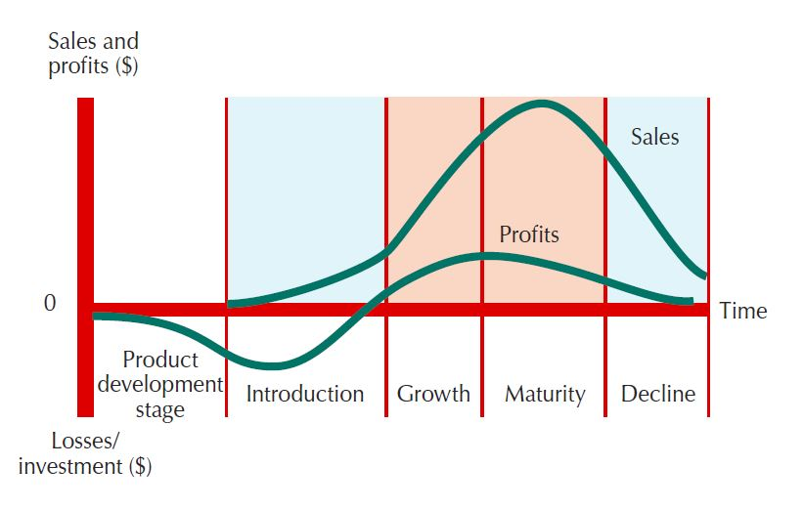
Product Life-Cycle Strategies
Product development
Zero sales and increasing investment costs
Introduction
Slow sales and nonexistent profits
Growth
Rapid market acceptance and increasing profits
Maturity
Slow sales growth and profits level off or decline
Decline
Sales fall off and profits drop

Slide 15
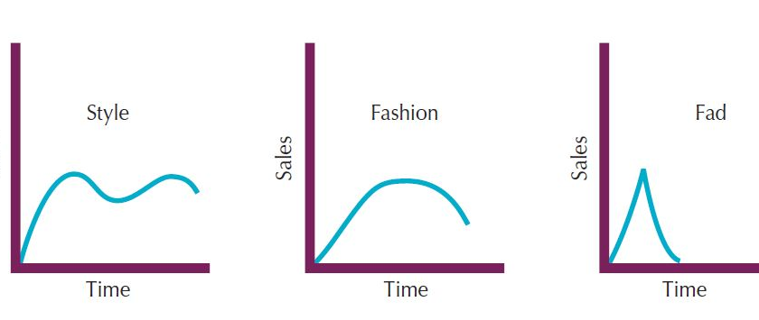
Product Life-Cycle Strategies
A fashion is a currently accepted or popular style in a given field. For example, the more formal “business attire” look of corporate dress of the 1980s and 1990s gave way to the “business casual” look of the 2000s. Fashions tend to grow slowly, remain popular for a while, and then decline slowly.
A style is a basic and distinctive mode of expression. For example, styles appear in homes (colonial, ranch, transitional), clothing (formal, casual), and art (realist, surrealist, abstract). Once a style is invented, it may last for generations, passing in and out of vogue. A style has a cycle showing several periods of renewed interest.
Fads are temporary periods of unusually high sales driven by consumer enthusiasm and immediate product or brand popularity.
Notes:
The PLC concept also can be applied to what are known as styles, fashions, and fads. Their special life cycles are shown in Figure 9.4.
A style is a basic and distinctive mode of expression. For example, styles appear in homes (colonial, ranch, transitional), clothing (formal, casual), and art (realist, surrealist, abstract). Once a style is invented, it may last for generations, passing in and out of vogue. A style has a cycle showing several periods of renewed interest.
A fashion is a currently accepted or popular style in a given field. For example, the more formal “business attire” look of corporate dress of the 1980s and 1990s gave way to the “business casual” look of the 2000s. Fashions tend to grow slowly, remain popular for a while, and then decline slowly.
Fads are temporary periods of unusually high sales driven by consumer enthusiasm and immediate product or brand popularity. A fad may be part of an otherwise normal life cycle, as in the case of recent surges in the sales of poker chips and accessories. Or the fad may comprise a brand’s or product’s entire life cycle. Pet Rocks are a classic example.
Marketers can apply the product life-cycle concept as a useful framework for describing how products and markets work. And when used carefully, the PLC concept can help in developing good marketing strategies for its different stages. However, using the PLC concept for forecasting product performance or developing marketing strategies presents some practical problems. For example, in practice, it is difficult to forecast the sales level at each PLC stage, the length of each stage, and the shape of the PLC curve. Using the PLC concept to develop marketing strategy also can be difficult because strategy is both a cause and a result of the PLC. The product’s current PLC position suggests the best marketing strategies, and the resulting marketing strategies affect product performance in later stages.

Slide 16
Product Life-Cycle Strategies
Introduction Stage
Slow sales growth
Little or no profit
High distribution and promotion expenses
Growth Stage
Sales increase
New competitors enter the market
Profits increase
Economies of scale
Consumer education
Lowering prices to attract more buyers
Notes:
The introduction stage starts when a new product is first launched. Well-known products such as frozen foods and HDTVs lingered for many years before they entered a stage of more rapid growth.
In this stage profits are negative or low because of the low sales and high distribution and promotion expenses. Firms focus their selling on those buyers who are the most ready to buy.
A company, especially the market pioneer, must choose a launch strategy that is consistent with the intended product positioning. It should realize that the initial strategy is just the first step in a grander marketing plan for the product’s entire life cycle. If the pioneer chooses its launch strategy to make a “killing,” it may be sacrificing long-run revenue for the sake of short-run gain. The pioneer has the best chance of building and retaining market leadership if it plays its cards correctly from the start. If the new product satisfies the market, it will enter a growth stage. The early adopters will continue to buy, and later buyers will start following their lead, especially if they hear favorable word of mouth.
As new competitors enter the market, they will introduce new product features, and the market will expand. The increase in competitors leads to an increase in the number of distribution outlets, and sales jump just to build reseller inventories. Companies keep their promotion spending at the same or a slightly higher level. Educating the market remains a goal, but now the company must also meet the competition.
Profits increase during the growth stage as promotion costs are spread over a large volume and as unit manufacturing costs decrease. The firm uses several strategies to sustain rapid market growth as long as possible:
Improving product quality
Adding new product features and models
Entering new market segments and new distribution channels
Shifting some advertising from awareness to building product conviction and purchase
Lowering prices at the right time to attract more buyers
In the growth stage, the firm faces a trade-off between high market share and high current profit. By spending a lot of money on product improvement, promotion, and distribution, the company can capture a dominant position. In doing so, however, it gives up maximum current profit, which it hopes to make up in the next stage.

Slide 17
Product Life-Cycle Strategies
Maturity Stage
Slowdown in sales
Many suppliers
Substitute products
Overcapacity leads to competition
Increased promotion and R&D to support sales and profits
Modification Strategies
Modify the market
Modify the product
Modify the marketing mix
Decline Stage
Maintain the product
Harvest the product
Drop the product
Notes:
The maturity stage normally lasts longer than the previous stages, and it poses strong challenges to marketing management. Most products are in the maturity stage of the life cycle, and therefore most of marketing management deals with the mature product.
The slowdown in sales growth results in many producers with many products to sell. In turn, this overcapacity leads to greater competition and a drop in profit. Some of the weaker competitors start dropping out, and the industry eventually contains only well-established competitors.
Although many products in the mature stage appear to remain unchanged for long periods, most successful ones are actually evolving to meet changing consumer needs. Product managers should do more than simply ride along with or defend their mature products—a good offense is the best defense.
They should consider modifying the market, product offering, and marketing mix. When modifying the market, the company tries to increase consumption by finding new users and new market segments for its brands.
Modifying the product involves changing characteristics such as quality, features, style, or packaging to attract new users and inspire more usage. The company can improve the product’s styling and attractiveness or improve the product’s quality and performance—durability, reliability, speed, and taste.
Modifying the marketing mix involves improving sales by changing one or more marketing mix elements. The company can offer new or improved services to buyers. It can cut prices to attract new users and competitors’ customers. It can launch a better advertising campaign or use aggressive sales promotions—trade deals, cents-off, premiums, and contests. In addition to pricing and promotion, the company can also move into new marketing channels to help serve new users. The sales of most product forms and brands eventually dip. The decline may be slow, as in the cases of stamps and oatmeal cereal, or rapid, as in the case of VHS tapes. Sales may plunge to zero, or they may drop to a low level where they continue for many years. This is the decline stage. Sales decline for many reasons, including technological advances, shifts in consumer tastes, and increased competition.
Carrying a weak product can be very costly to a firm, and not just in profit terms. There are many hidden costs. A weak product may take up too much time and resources that might be better used to make “healthy” products more profitable, and a product’s failing reputation can cause customer concerns about the company and its other products. The biggest cost may well lie in the future. Keeping weak products delays the search for replacements, creates a lopsided product mix, hurts current profits, and weakens the company’s foothold on the future.
For these reasons, companies must identify products in the decline stage and decide whether to maintain, harvest, or drop them. Management may decide to maintain its brand, repositioning or reinvigorating it in hopes of moving it back into the growth stage of the product life cycle. Management may decide to harvest the product, which means reducing various costs (plant and equipment, maintenance, R&D, advertising, sales force), hoping that sales hold up. Finally, management may decide to drop the product from its line. The company can sell the product to another firm or simply liquidate it at salvage value. If the company plans to find a buyer, it will not want to run down the product through harvesting.
On the next two slides, Table 9.2 summarizes the key characteristics of each stage of the PLC. The table also lists the marketing objectives and strategies for each stage.

Slide 18
Product Life-Cycle Strategies
Blank | Introduction | Growth | Maturity | Decline
Characteristics | Blank | Blank | Blank | Blank
Sales | Low sales | Rapidly rising sales | Peak sales | Declining sales
Costs | High cost per customer | Average cost per customer | Low cost per customer | Low cost per customer
Profits | Negative | Rising profits | High profits | Declining profits
Customers | Innovators | Early adopters | Mainstream adopters | Lagging adopters
Competitors | Few | Growing number | Stable number beginning to decline | Declining number
Table 9.2 Summary of Product Life-Cycle Characteristics, Objectives, and Strategies

Slide 19
Product Life-Cycle Strategies
Blank | Introduction | Growth | Maturity | Decline
Marketing objectives | Create product engagement and trial | Maximize market share | Maximize profit while defending market share | Reduce expenditure and milk the brand
Strategies | Blank | Blank | Blank | Blank
Product | Offer a basic product | Offer product extensions, service, and warranty | Diversity brand and models | Phase out weak items
Price | Use cost-plus | Price to penetrate market | Price to match or beat competitors | Cut price
Distribution | Build selective distribution | Build intensive distribution | Build more intensive distribution | Go selective: phase out unprofitable outlets
Table 9.2 [continued]

Slide 20
Product Life-Cycle Strategies
Blank | Introduction | Growth | Maturity | Decline
Advertising | Build product awareness among early adopters and dealers | Build engagement and interest in the mass market | Stress brand differences and benefits | Reduce to level needed to retain hard-core loyals
Sales promotion | Use heavy sales promotion to entice trial | Reduce to take advantage of heavy consumer demand | Increase to encourage brand switching | Reduce to minimal level
Table 9.2 [continued]

